Slide 1

RV Trip Planning
Tools, Tips and Tricks for Making the Most of Your Next Trip!
September 3rd, 2021

Slide 2
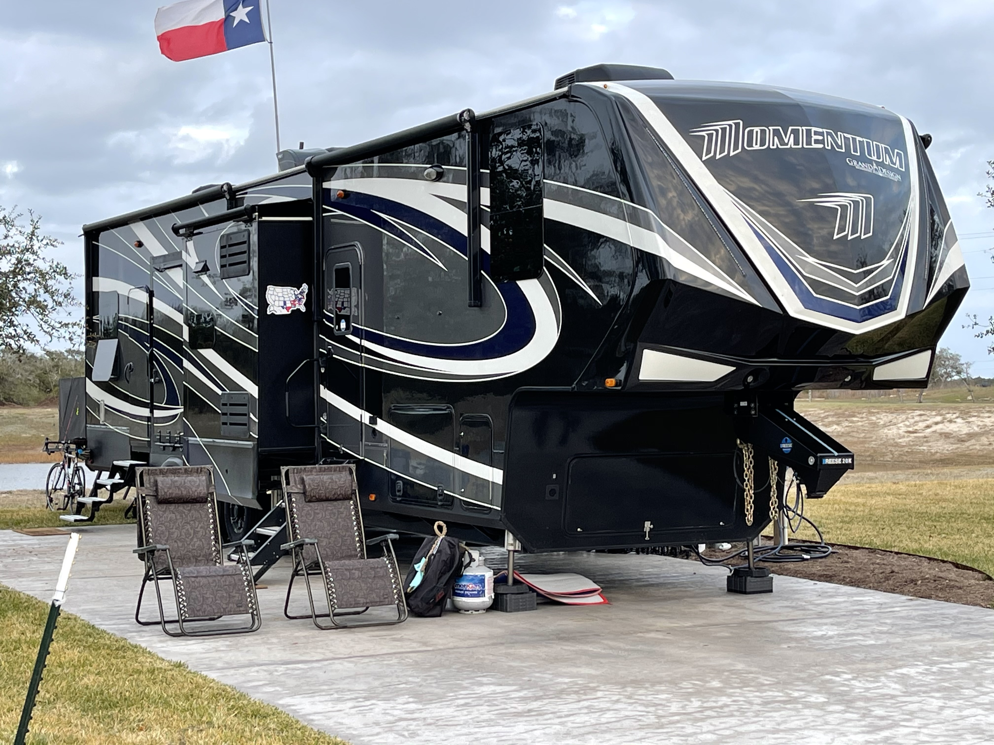
Welcome Grand Design Family!

Slide 3

Our Agenda …
Our story …
Some important mindsets …
The tools we use …
The tools we don’t use just yet …
Planning a short trip …
Planning a long trip …
Follow Up …
Q&A!

Slide 4

WARNING …
If anyone tells you there is only one way … RUN!
This is how we do it and what works for us!
Take what you want/like …
Ignore the rest!
We are going to cover a LOT … SO!

Slide 5
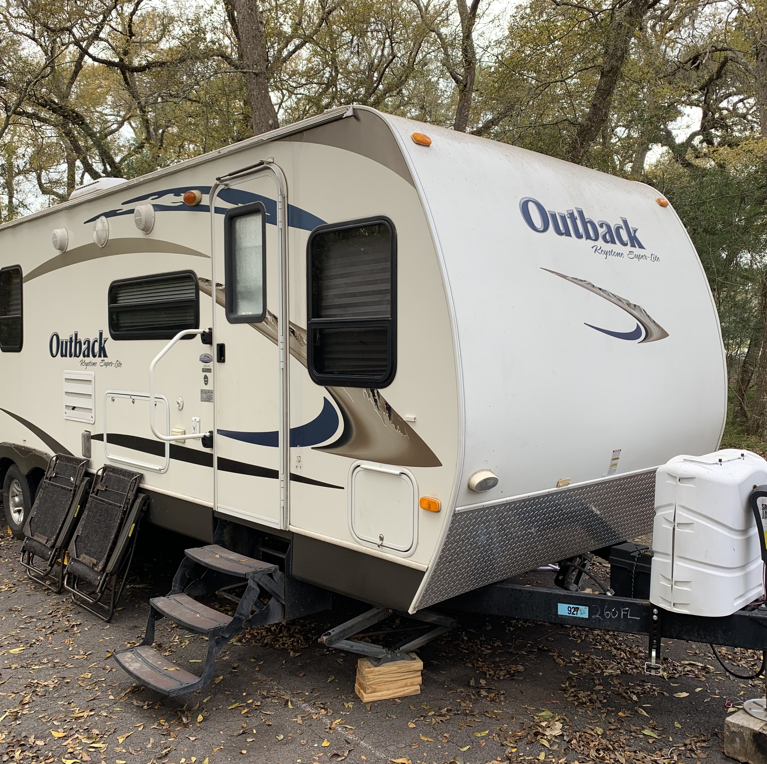
A Quote …
“Destiny is what you are supposed to do in life. Fate is what kicks you in the ass to make you do it!” Henry Miller

Slide 6
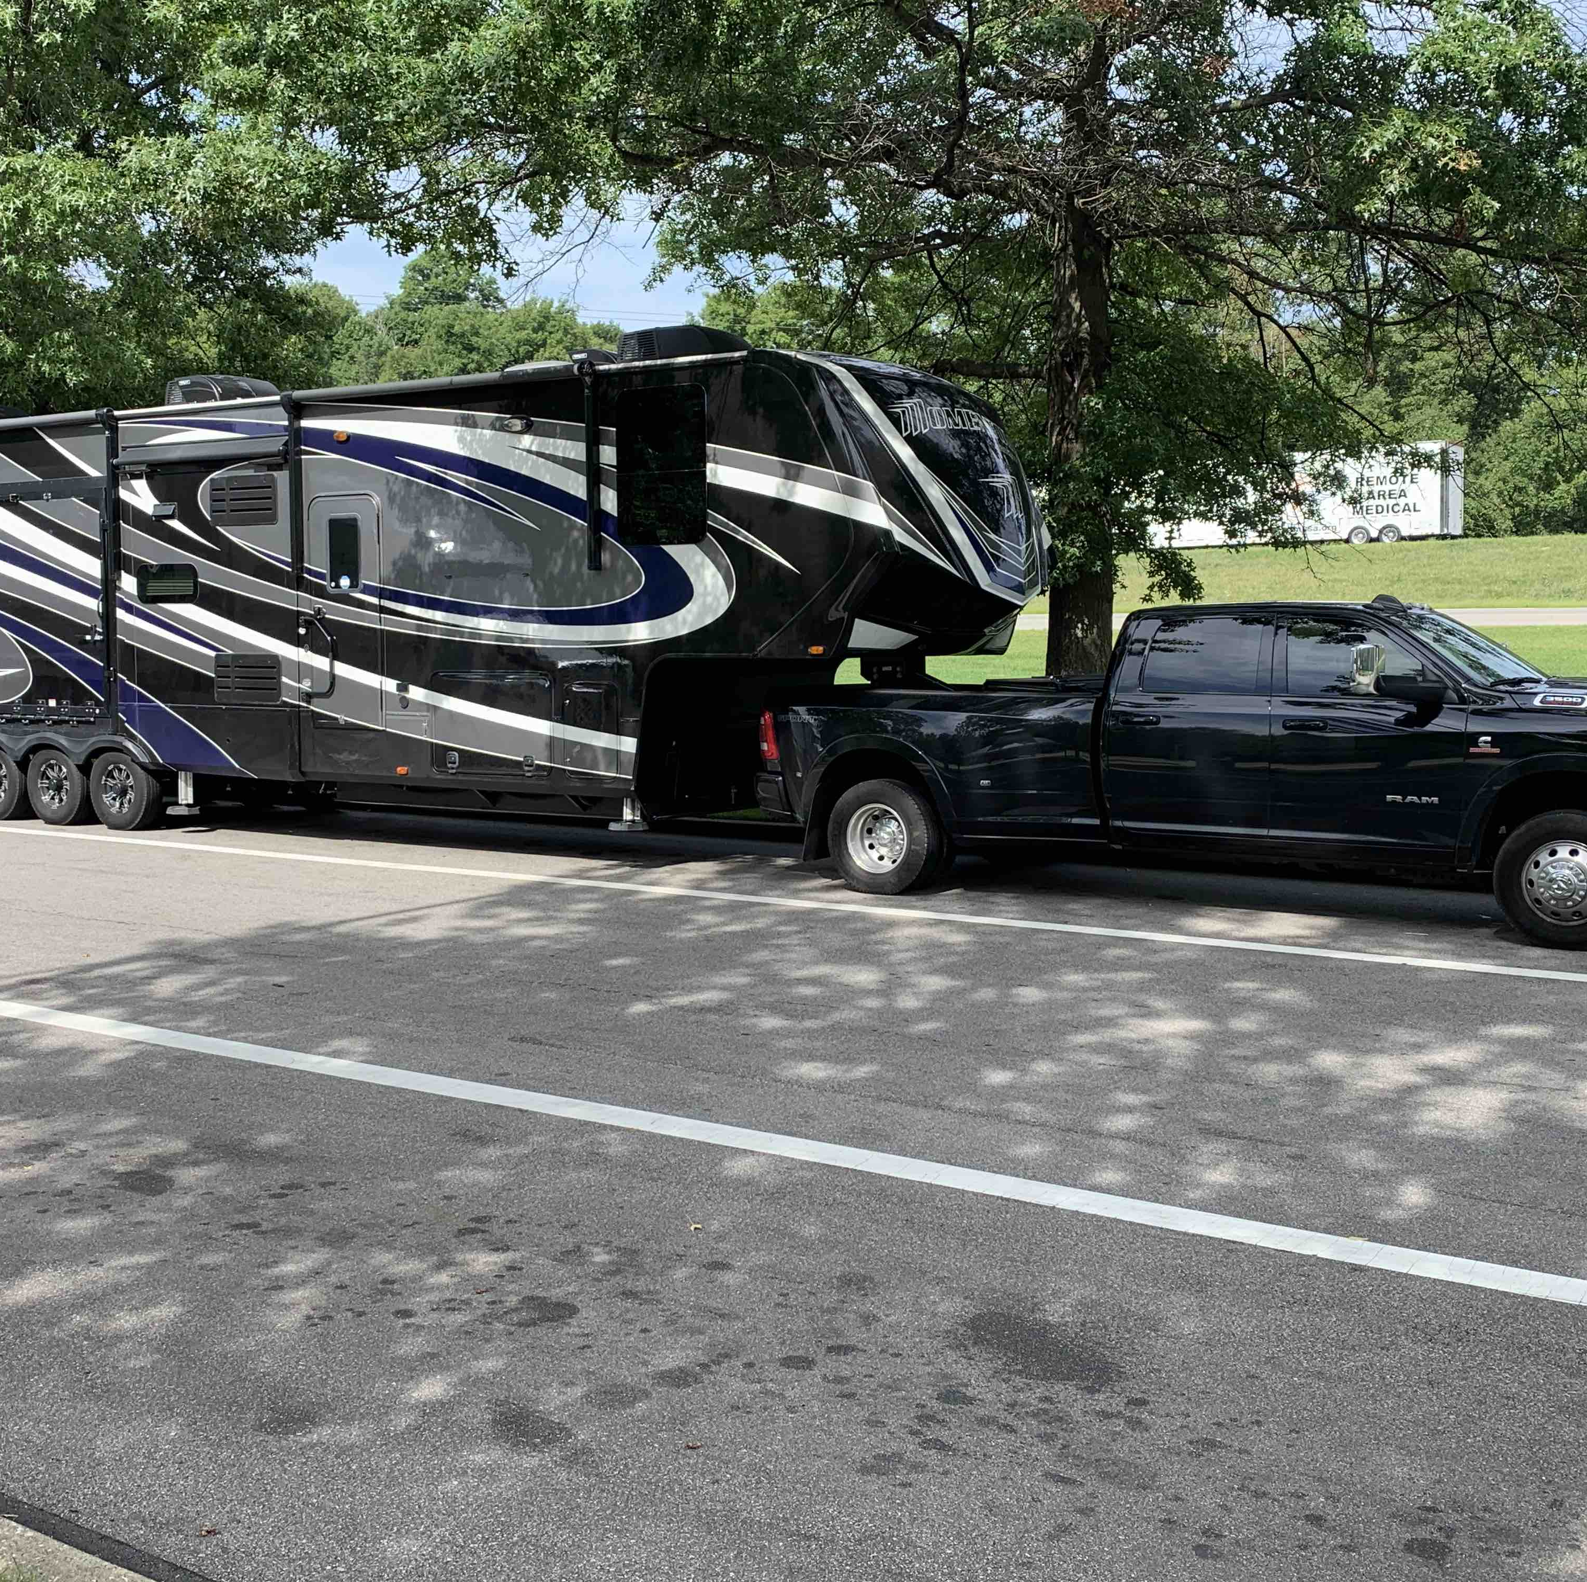
A Quote …
“Destiny is what you are supposed to do in life. Fate is what kicks you in the ass to make you do it!” Henry Miller

Slide 7
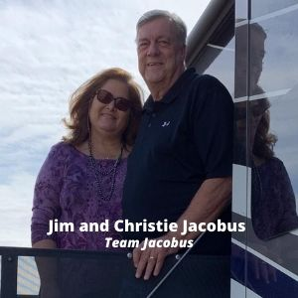
Our Story …

Slide 8
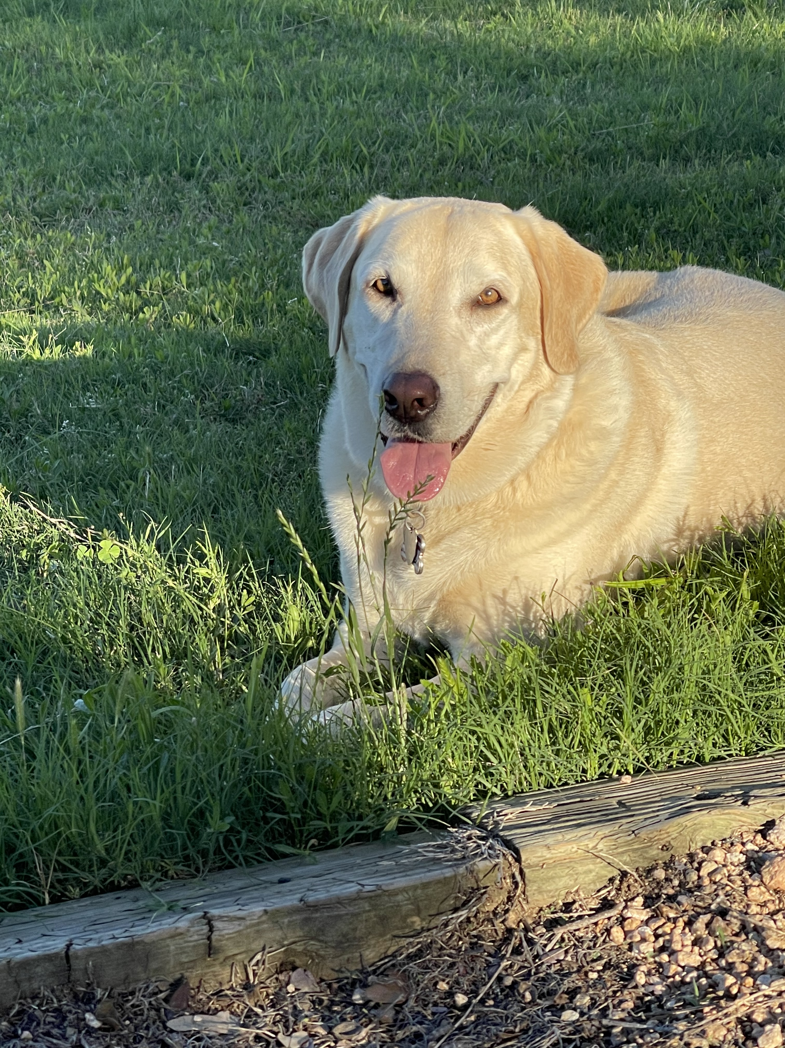
This Is marley …

Slide 9
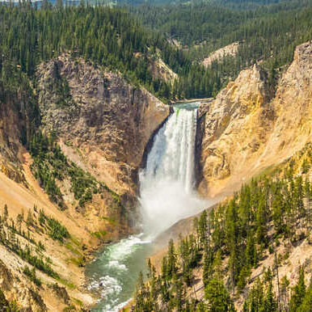
Mindset is critical …
We can always find a place to stay!
Be flexible!!!
We only require 2 things!
we have earned to laugh at, and learn from, our mistakes!
We make the most of what we have to deal with!
We are in this together!!!

Slide 10

Our Big Plan …
South Texas …
North Texas …
“Travel Trailer”!

Slide 11

How We Decide Where …
Christie Has Her “Bucket List” …
Jim Has His “Bucket List” …
We have “Our Bucket List” …

Slide 12
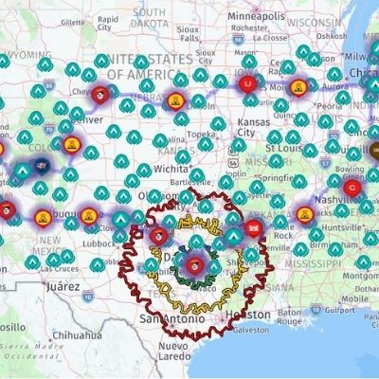
Our Tools
Include …
ReserveAmerica.com … State Parks
Recreation.Gov … National Parks and Corps of Engineers (COE)
Kampgrounds of America … KOA
Harvest Host … Boondocking
Currently we do not use BLM, HipCamp, Boondockers Welcome and similar. Would love to learn more about those!
RV Trip Wizard … is the backbone!
  RV Life App
  RVTripWizard.com
Garmin 785 RV

Slide 13
RV Trip Wizard Setup…
Set up your account …
Set up your default settings …
Open up a new trip …
Set defaults for the new trip …
Set your filters …
Plan your trip!

Slide 14
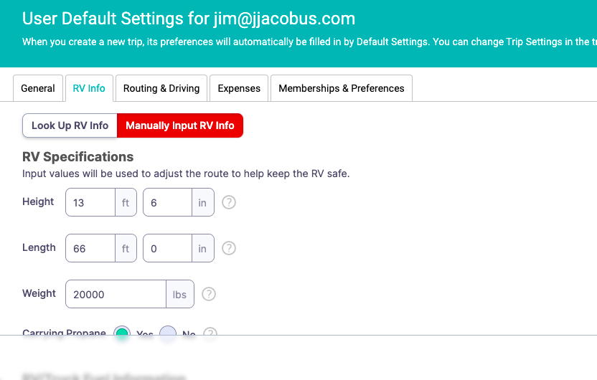
Set Up Your Account … RV Info

Slide 15
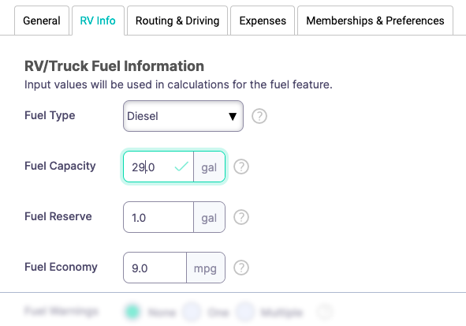
Set Up Your Account … RV Info

Slide 16
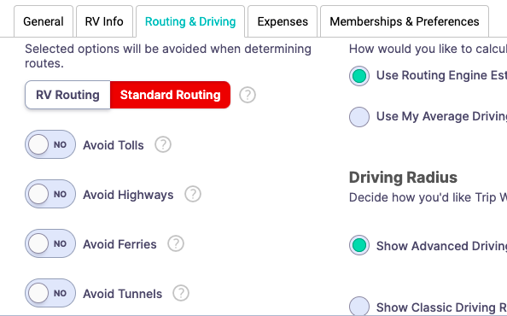
Set Up Your Account … Routing Preferences

Slide 17
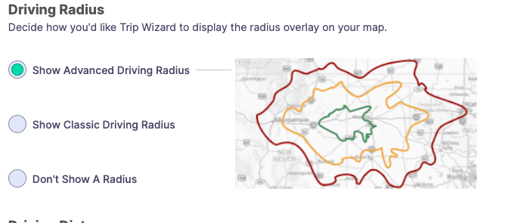
Set Up Your Account … Routing Preferences

Slide 18
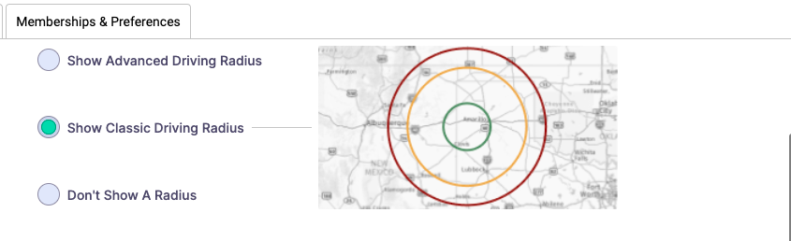
Set Up Your Account … Routing Preferences

Slide 19
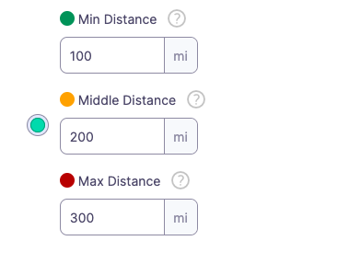
Set Up Your Account … Distance Preferences

Slide 20
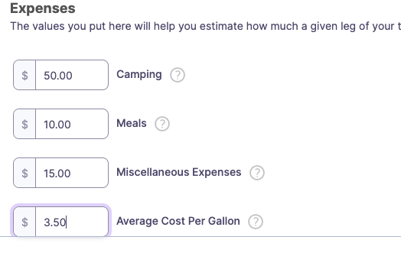
Set Up Your Account … Estimated Expenses

Slide 21
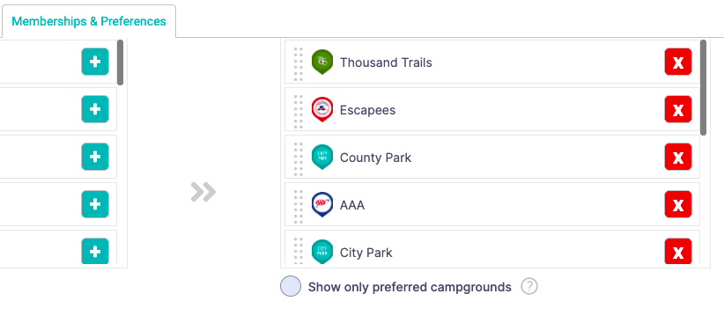
Set Up Your Account … Memberships

Slide 22
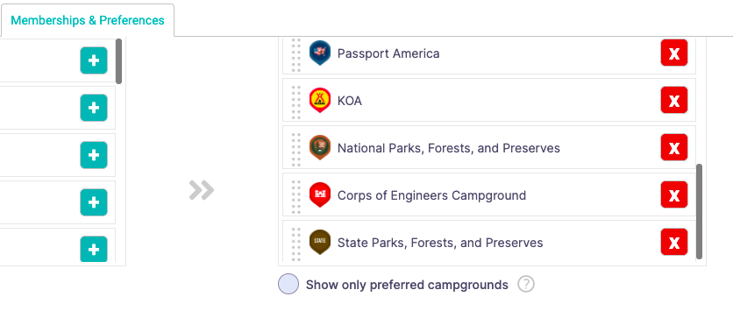
Set Up Your Account … Memberships

Slide 23
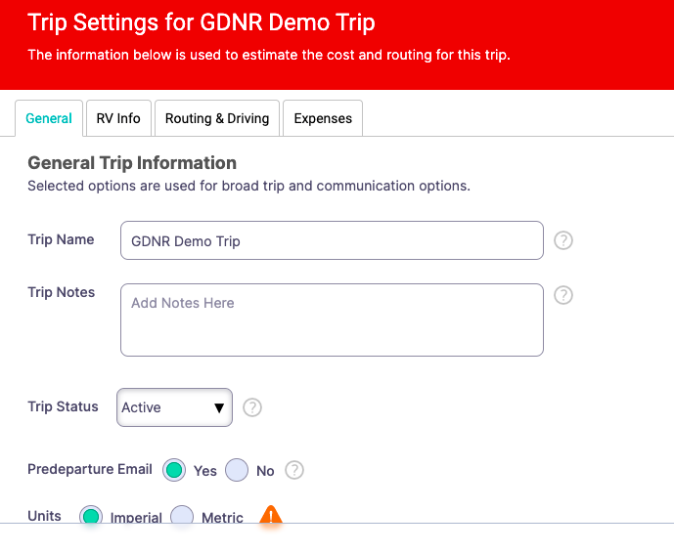
Set Up New Trip … Defaults

Slide 24
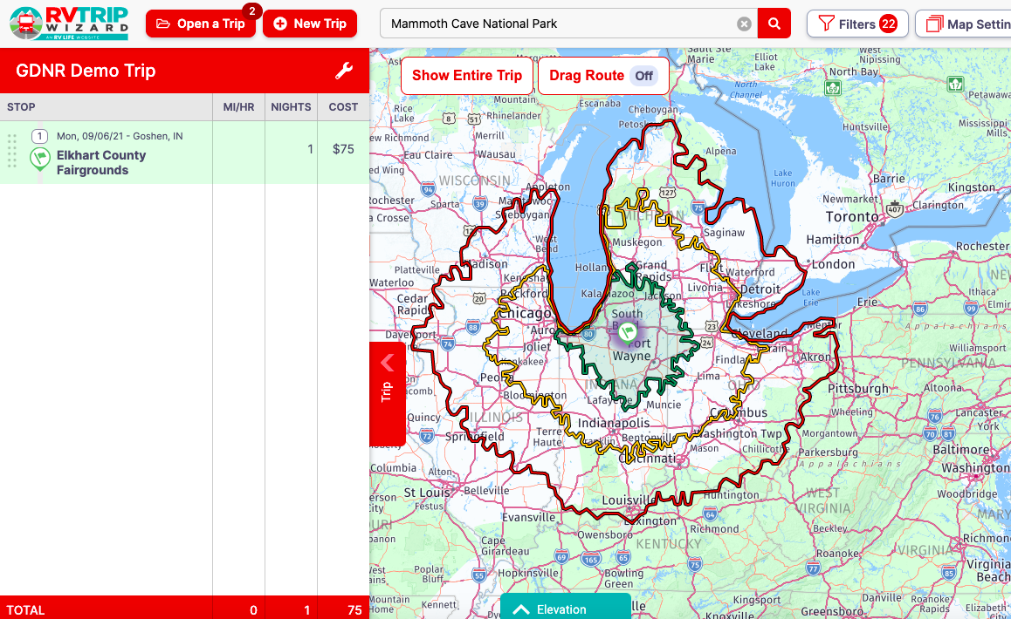
Set Up New Trip …

Slide 25
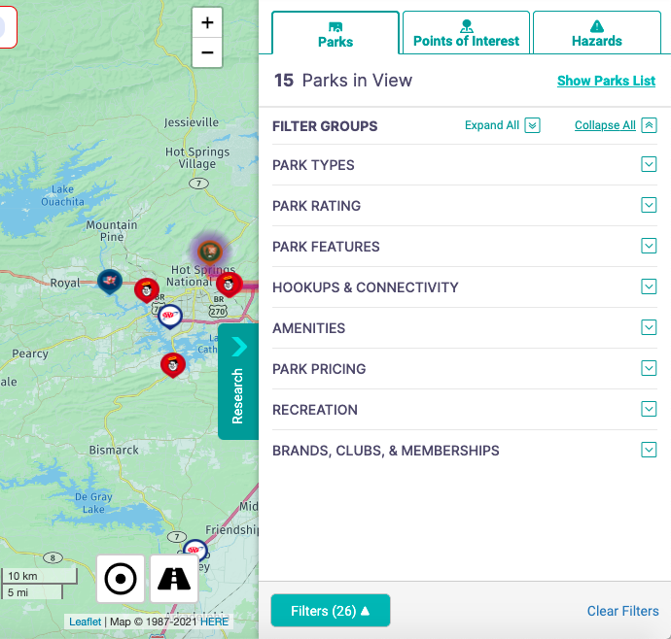
Set Up Your Filters … Lots of Options!!!

Slide 26
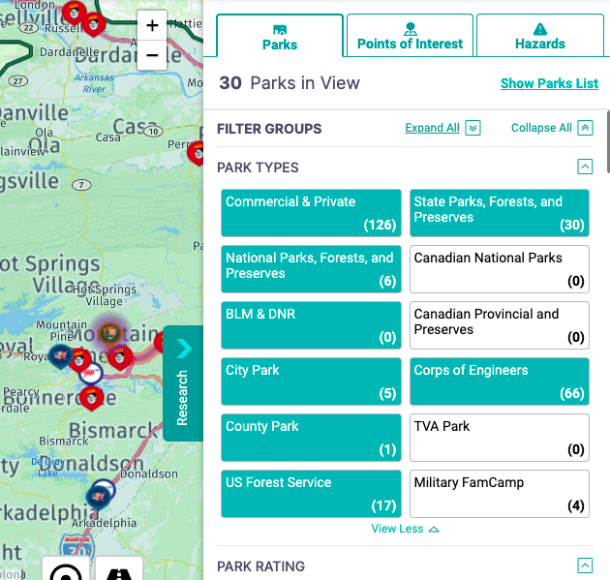
Set Up Your Filters … Park Types!

Slide 27
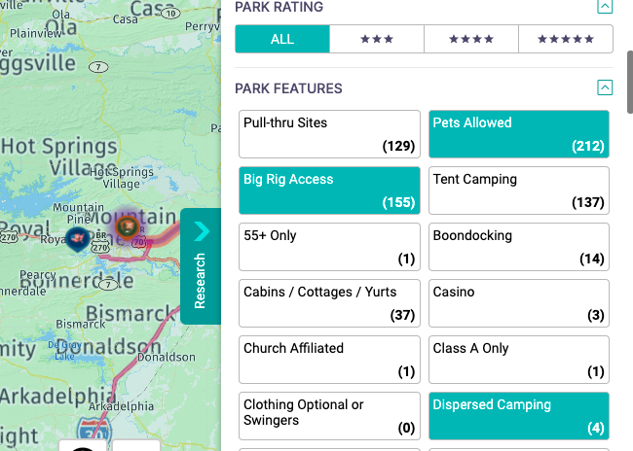
Set Up Your Filters … Ratings and Features!

Slide 28
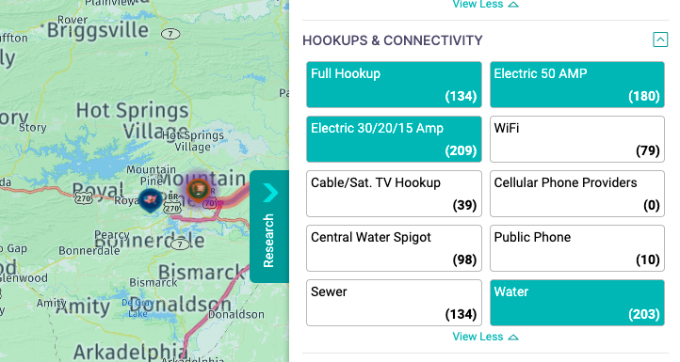
Set Up Your Filters … Setup Options!

Slide 29
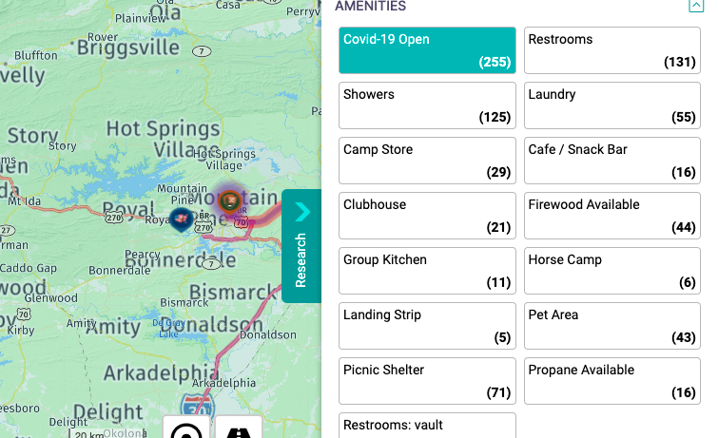
Set Up Your Filters … Amenities?

Slide 30
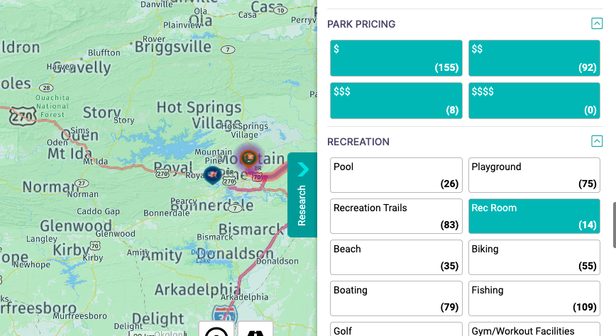
Set Up Your Filters … Pricing?

Slide 31
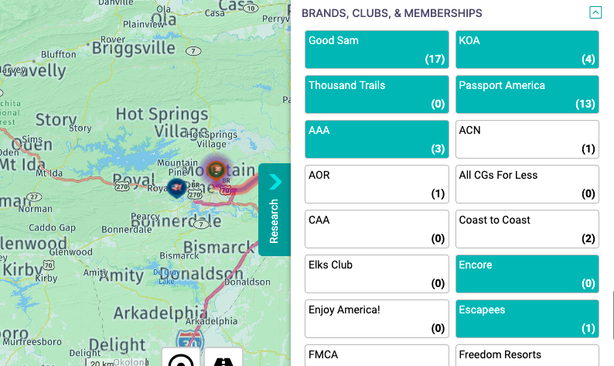
Set Up Your Filters … Favorites?

Slide 32
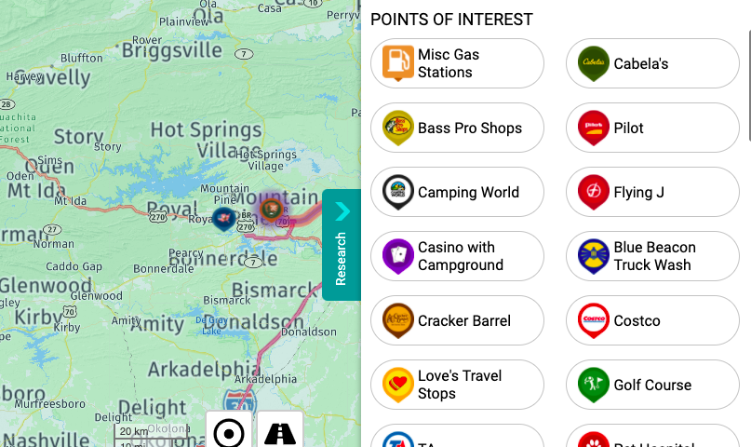
Set Up Your Filters … Points of Interest?

Slide 33
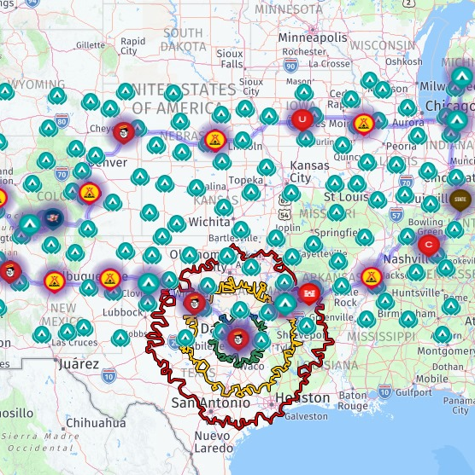
Planning A Short Trip …
Start with Point A and departure date!
Add Point B and arrival
date …
Look for places to stay …
DO YOUR RESEARCH!!!
Book your stay …

Slide 34
Point A …

Slide 35
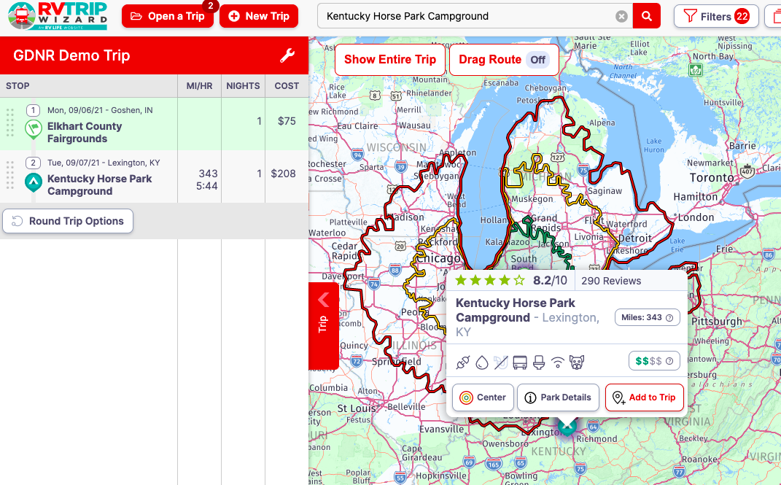
Point B … A Specific Campground!

Slide 36
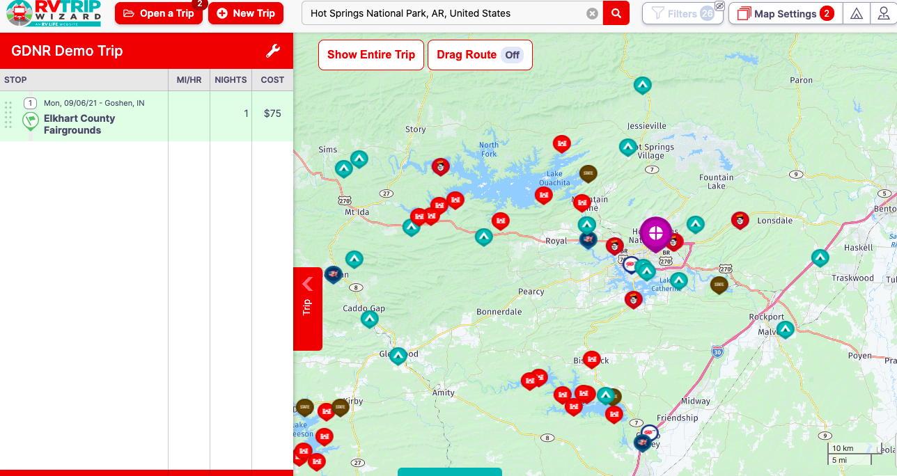
Point B … A General Area!

Slide 37
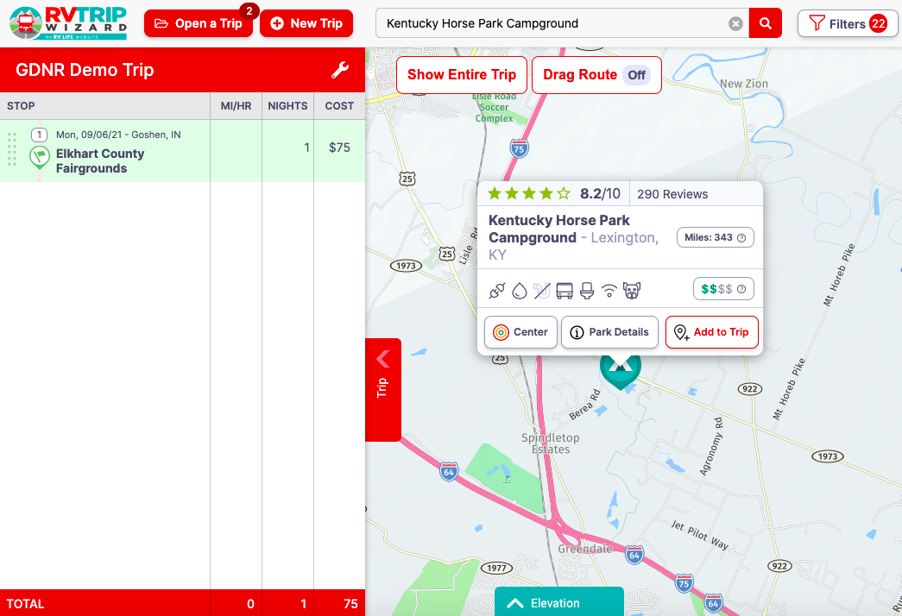
DO YOUR RESEARCH!!!

Slide 38
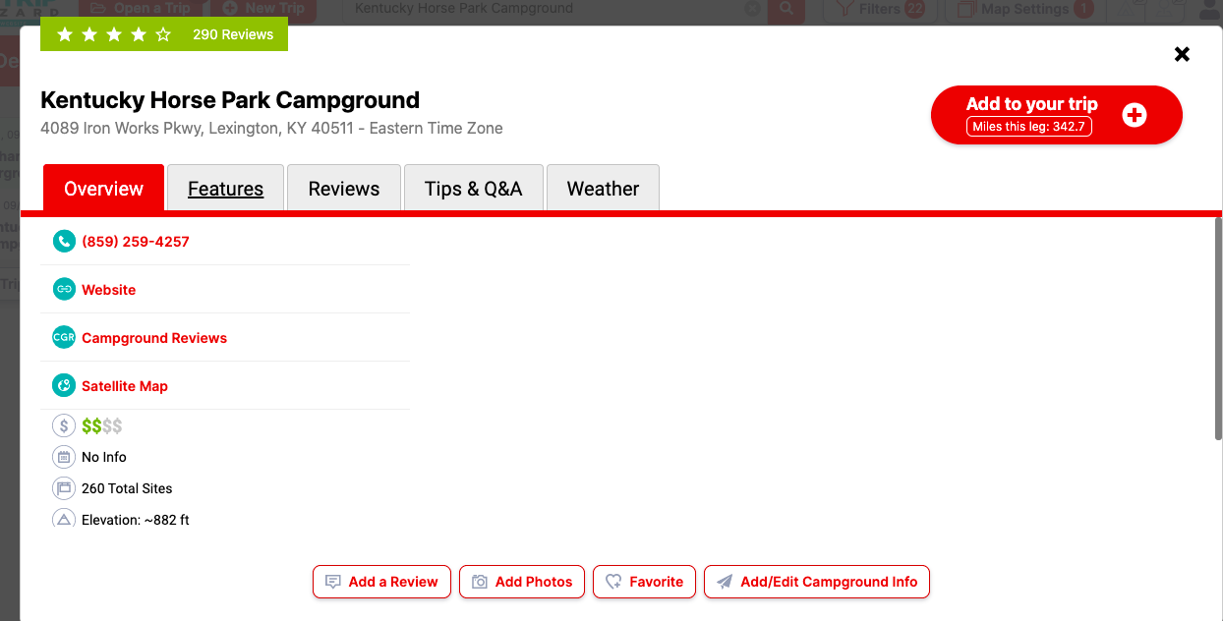
DO YOUR RESEARCH!!!

Slide 39

DO YOUR RESEARCH!!!

Slide 40
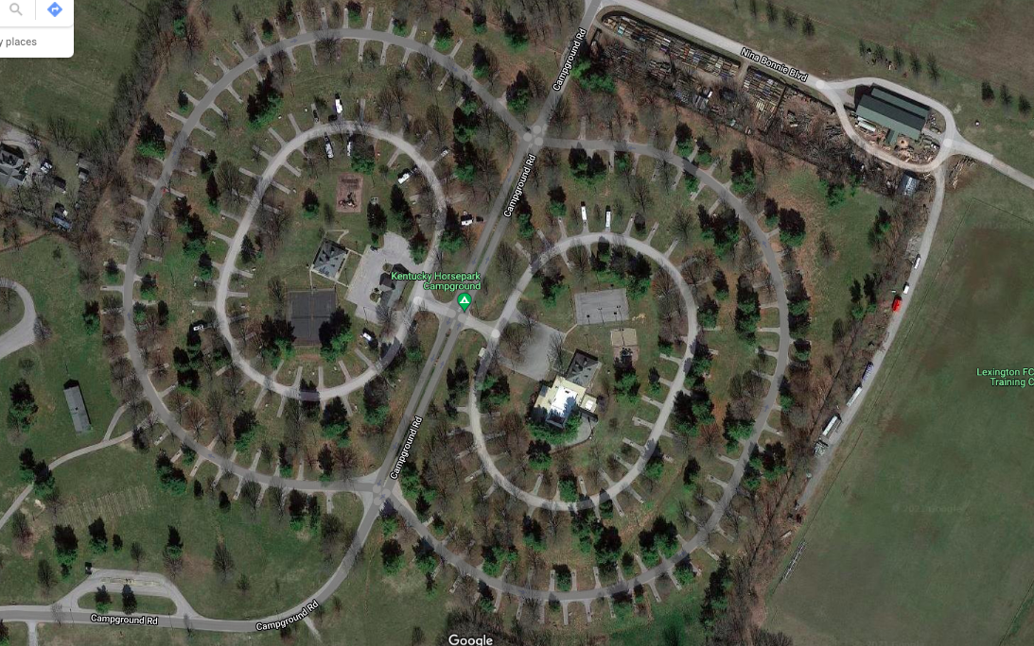
DO YOUR RESEARCH!!!

Slide 41
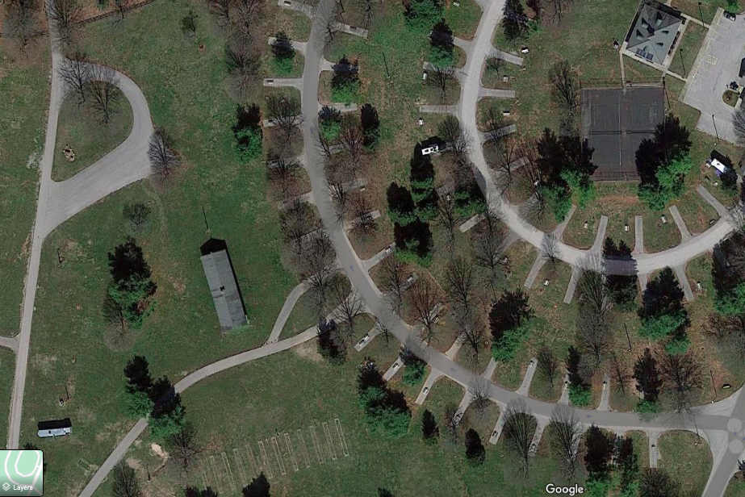

DO YOUR RESEARCH!!!
#141

Slide 42

DO YOUR RESEARCH!!!

Slide 43
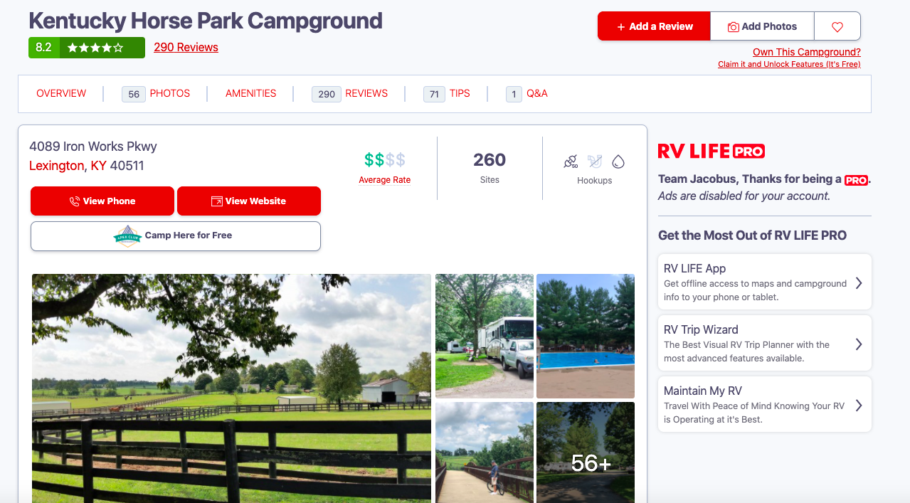
DO YOUR RESEARCH!!!

Slide 44
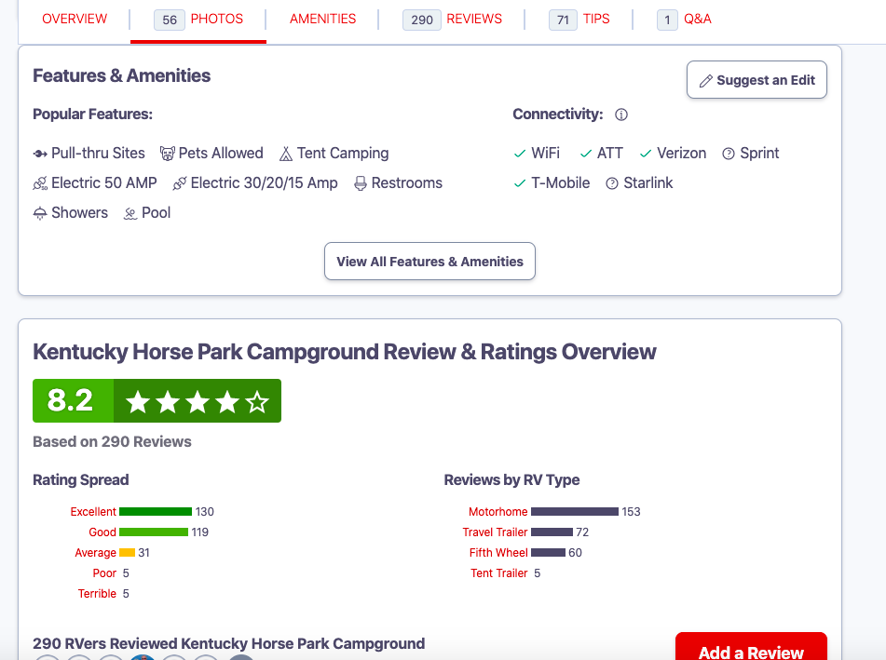
DO YOUR RESEARCH!!!

Slide 45
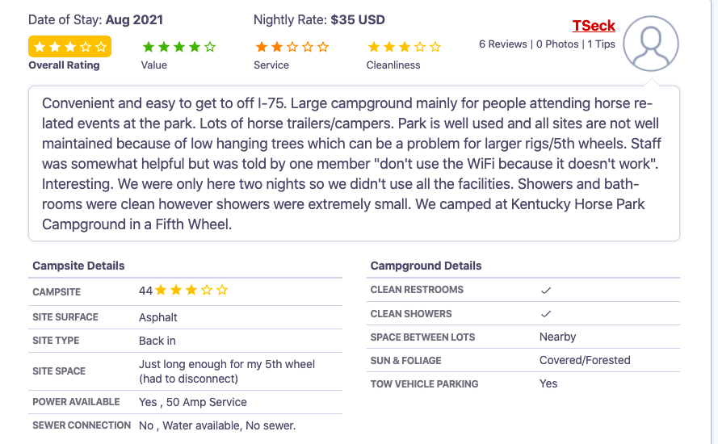
DO YOUR RESEARCH!!!

Slide 46
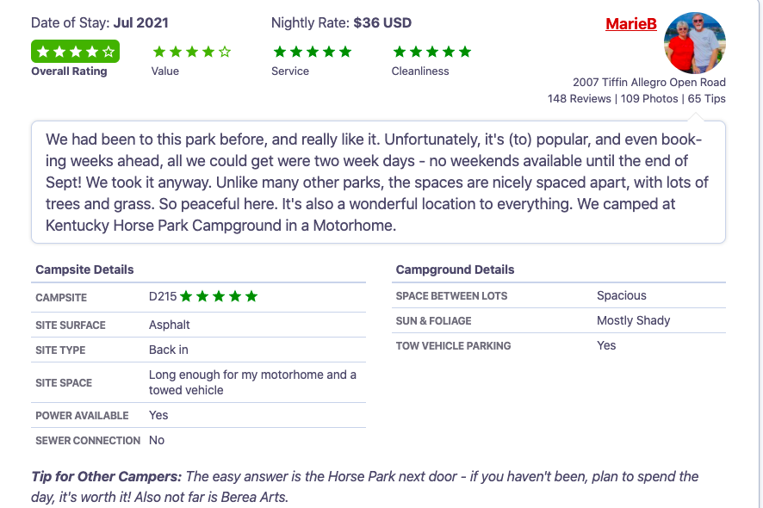
DO YOUR RESEARCH!!!

Slide 47
Planning A Long Trip …
Same as short … Point A, Point B, start and stop dates
Crowd source ... best route, places to stay, things to see
Plan your stops, length of stay, use a placeholder
NOTE: We use the 3:30/330 rule as a guide!
Look for places to stay
Research the options
Book your stays
Book your excursions, side trips, sightseeing
ENJOY the anticipation of planning and looking forward to your trip!!!

Slide 48
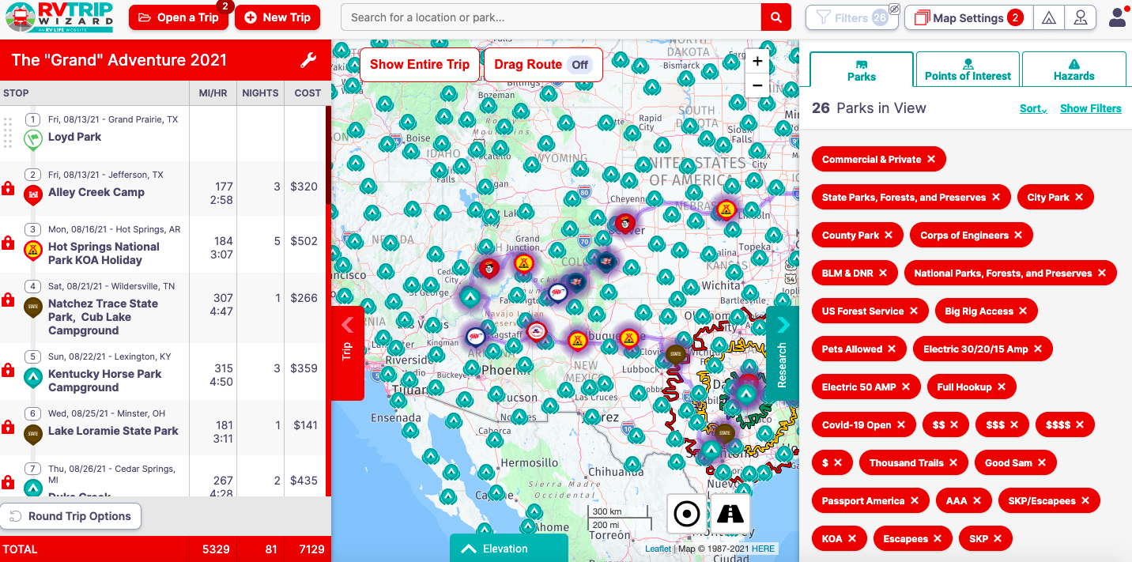
A Full Dashboard …

Slide 49


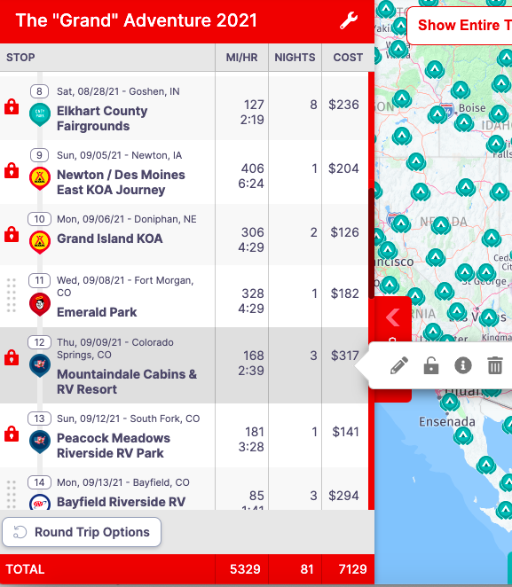
Our Trip From Here …

Slide 50
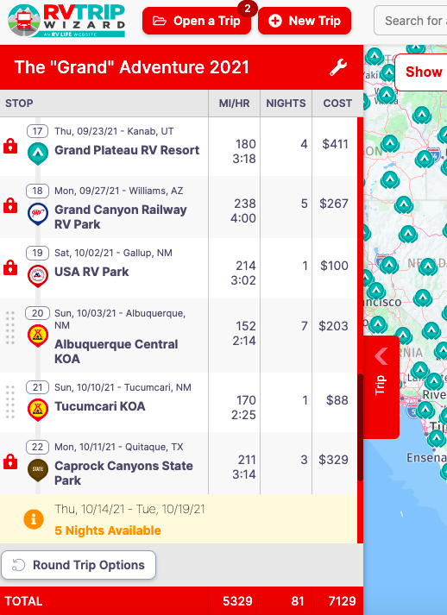
We Always Leave Open Days!

Slide 51
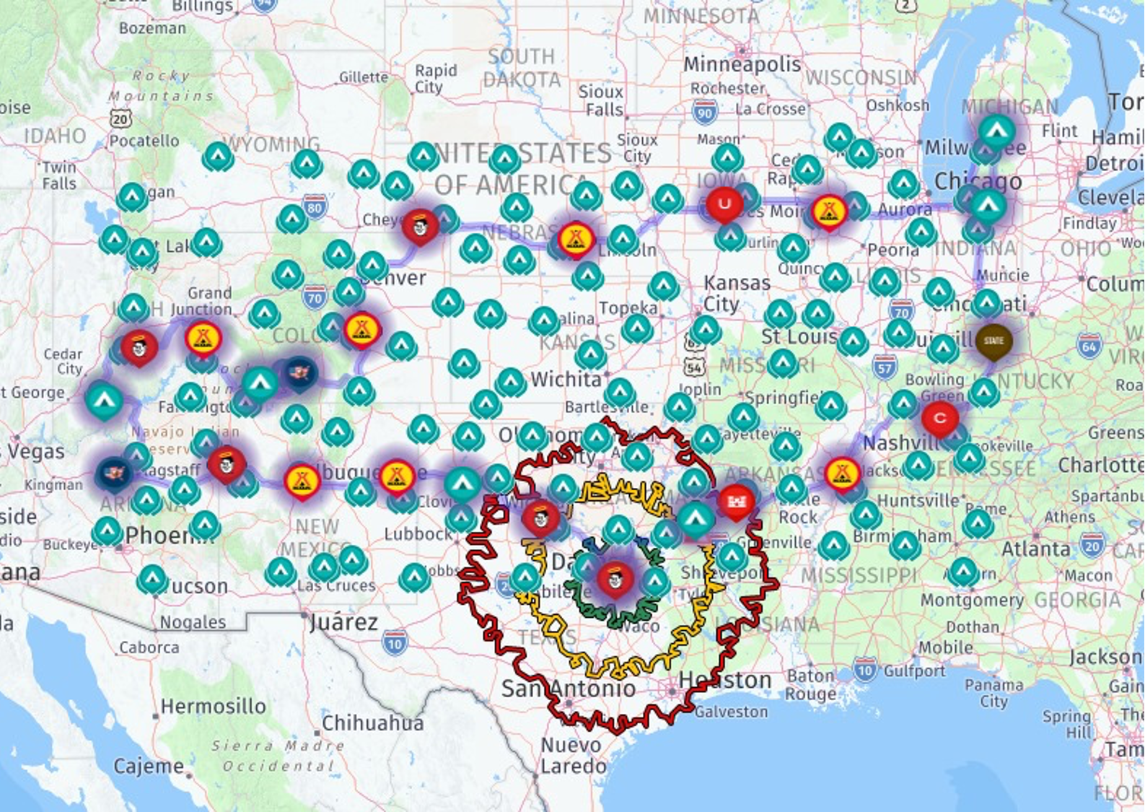
Some Freebies!!!
50% off RV Life & RV Trip Wizard – GRANDRV2021

Slide 52
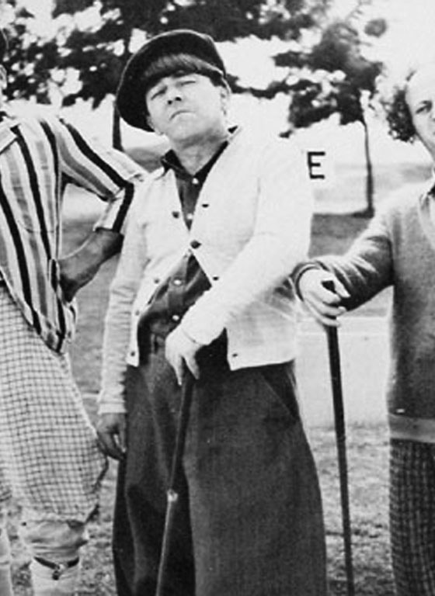
Q&A …

Slide 53
Follow Up & Stay
In Touch … www.joyhauling.com
Facebook – JoyHauling With Team Jacobus
Facebook – Grand Design National Rally Page

