Slide 1
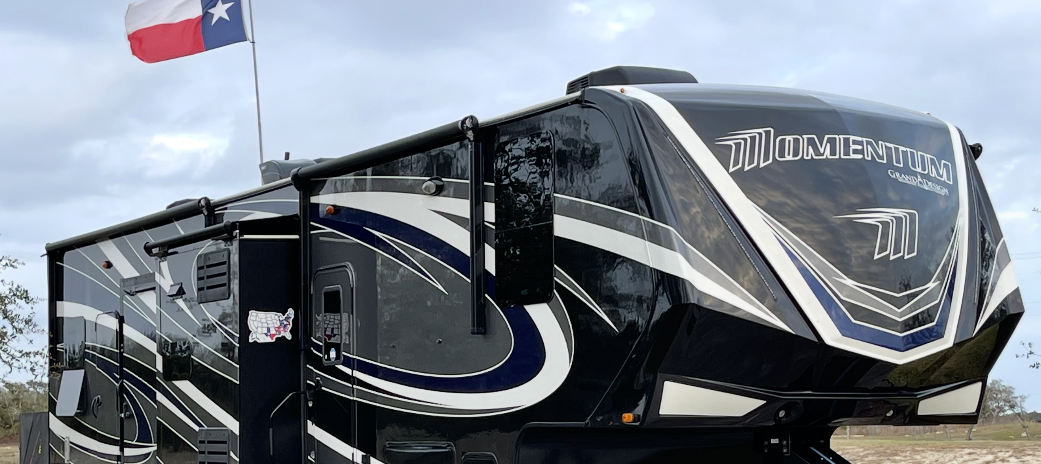
How To Confidently Buy Your Next Grand Design and Save $1,000’s of Dollars In the Process!!!
August 28th, 2025
Grand Design National Owners Rally

Slide 2
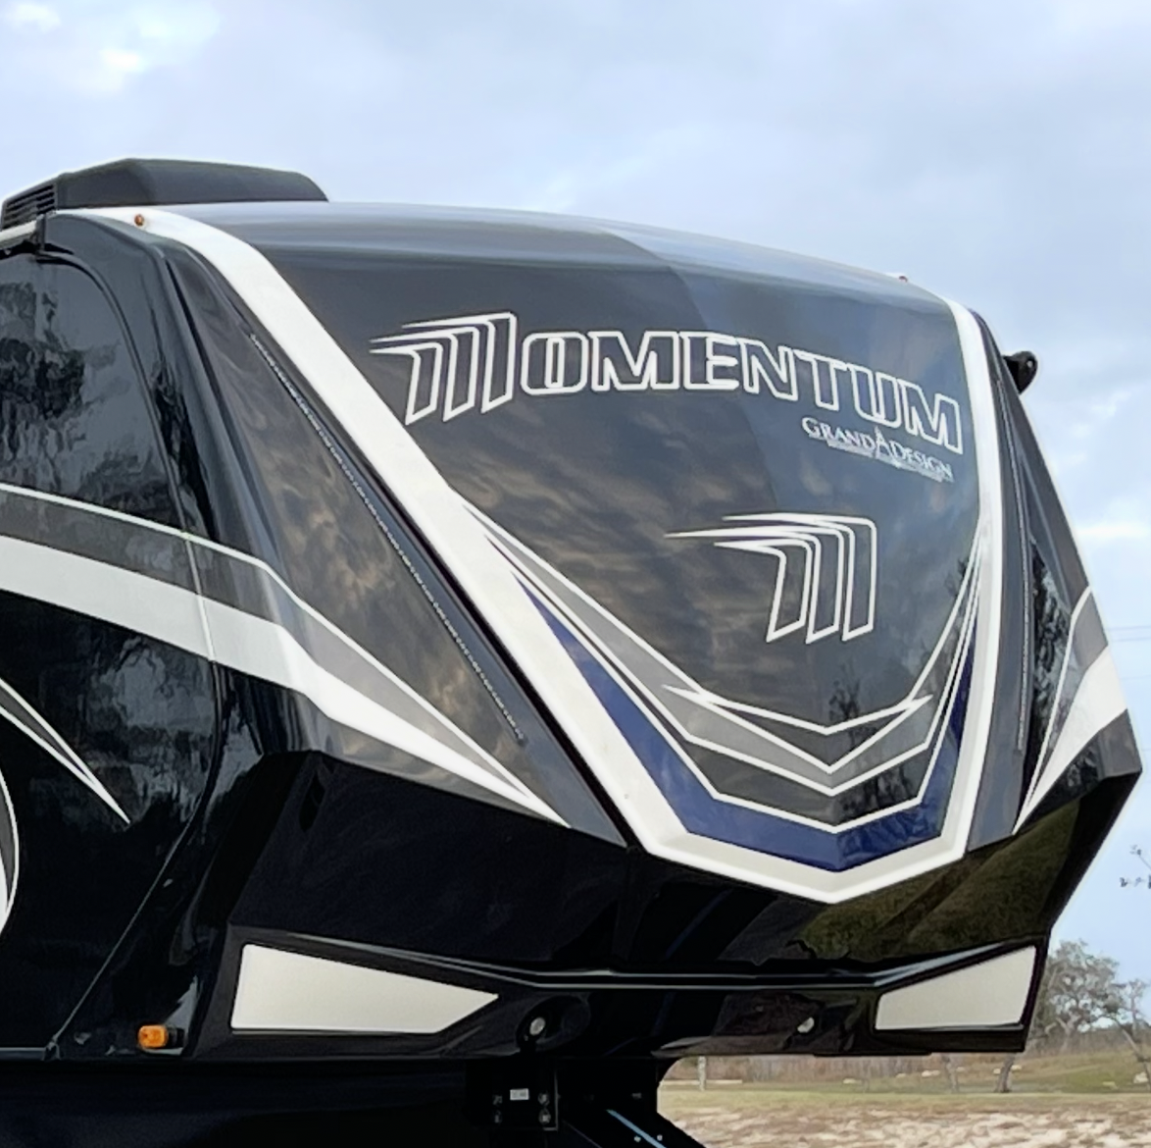
📋 Agenda – What We’ll Cover
Building Buyer Confidence
Making the Right Choice – Floor Plan, Manufacturer, Dealer, Salesperson
Financing Your RV Purchase
The 'Game' of Buying – Discounts, Timing & Negotiation
Mindset Tips & Strategies

Slide 3
✅ What Is Confidence?
“Confidence is knowing you have the right knowledge, tools, and strategies so you can walk onto a dealer’s lot calm, prepared, and in control — instead of anxious, uncertain, or easily swayed.”

Slide 4
✨ What Creates Confidence?
Knowledge – understanding the process
Preparation – doing your homework in advance!
Tools & Strategies – keep it simple!
Experience?
Mindset – calm, focused belief in your preparation.

Slide 5
How do you know when a sales person is lying?
“Buyers are liars”!?!

Slide 6
A Good Deal Is A State of Mind!!!

Slide 7
Making the Right Choice!
Floor Plan • Manufacturer • Dealer • Salesperson

Slide 8
🛋️ Choosing the Right Floor Plan
Match the floor plan to your travel style (weekend, seasonal, full-time).
Prioritize must-haves vs. nice-to-haves.
On a scale of 1 to 10?!?
See as many floor plans as necessary until you find “The One”!!!
TAKE YOUR TIME!!!
www.rvtrader.com is a great tool!

Slide 9

Choosing the Right Manufacturer

Slide 10
🏢 Choosing the Right Dealer
Once you are set on your floor plan(s) …
Get a spec sheet for that floor plan …
Spec out the “exact” unit you want to purchase …
Submit this to “Your” sales rep at 3 to 5 dealers!
Ask for a quote … Cash price out the door only what is required!
Google research your top candidates … or?!?

Slide 11
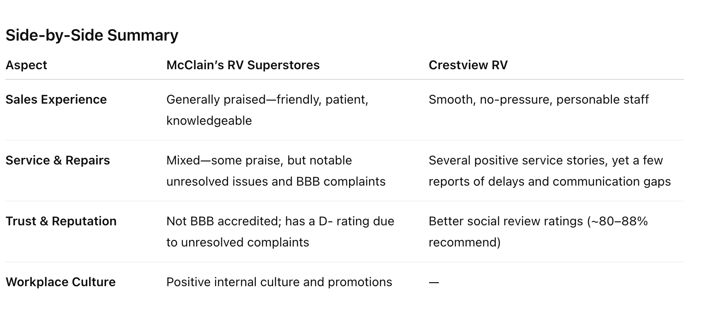
Chat GPT for the Win!!!

Slide 12
🏢 Choosing the Right Dealer
Choose Your Floor Plan …
Get a spec sheet for that Floor Plan …
Spec out the “exact” unit you want to purchase …
Submit this to “Your” sales rep at 3 to 5 dealers!
Ask for a quote … Cash price out the door!
Google research your top candidates … or?!?
Make an informed decision!!!
A quick word about service!!!

Slide 13
🤝 Choosing the Right Salesperson
A Script …
"I was talking to someone that bought a Grand Design from you guys recently, and they said the experience was fantastic—especially their salesperson. They mentioned their salesperson was one of your top people and had been there a while, but I didn’t write the name down. Could you help me figure out who that might have been?"

Slide 14
✨ Buying New vs Buying Used …
Full warranty coverage
Latest features & technology
Customization options
Higher upfront cost
Steeper depreciation

Slide 15
💰 Buying New vs Buying Used …
Lower purchase price
Less depreciation hit
Upgrades often included
Shorter/expired warranty
Potential hidden maintenance issues

Slide 16
Summary …
TAKE YOUR TIME!!!
Choose the right floor plan …
Pick the right dealer …
Get a rockstar salesperson …
Enjoy the process!!!
Ps … TAKE YOUR TIME!!!

Slide 17
Financing Your RV Purchase
Why Pre-Approval Puts You in Control

Slide 18
You Must Absolutely …
Before you start … know YOUR credit score!!!

Slide 19
💳 Financing Options …
Credit Unions – often lowest rates, member-focused.
Banks – convenient if you’re already a customer.
RV Specialty Lenders – understand long-term RV loans.
Home Equity Loans/HELOC – lower rates, but home is collateral.
Personal Loans – simple, unsecured, usually higher rates.
Cash is always king!!!

Slide 20
✅ Pre-Approval Is Power
Gives you leverage – the dealer knows you don’t need their financing.
Sets your budget clearly and avoids overspending.
Allows you to negotiate RV price and financing separately.
Is an important mindset!!!

Slide 21
🏦 Compare Lenders
Banks & Credit Unions – often lower rates and fewer fees.
RV Specialty Lenders – understand longer terms and higher amounts.
Dealer Financing – convenient but often marked up with extras.

Slide 22
📑 Understand Loan Terms
Interest rate – even small differences add up over 10–15 years.
Term length – lower payments vs. higher total interest paid.
Fees & penalties – watch for prepayment penalties or hidden fees.

Slide 23
⚠️ Beware of Add-Ons in Financing
Let the dealer Compete for your business!!!
Dealers roll in warranties, service contracts, or protection plans.
Always ask: ‘Is this required?’ before signing.
Many add-ons can be purchased cheaper outside the dealer.

Slide 24
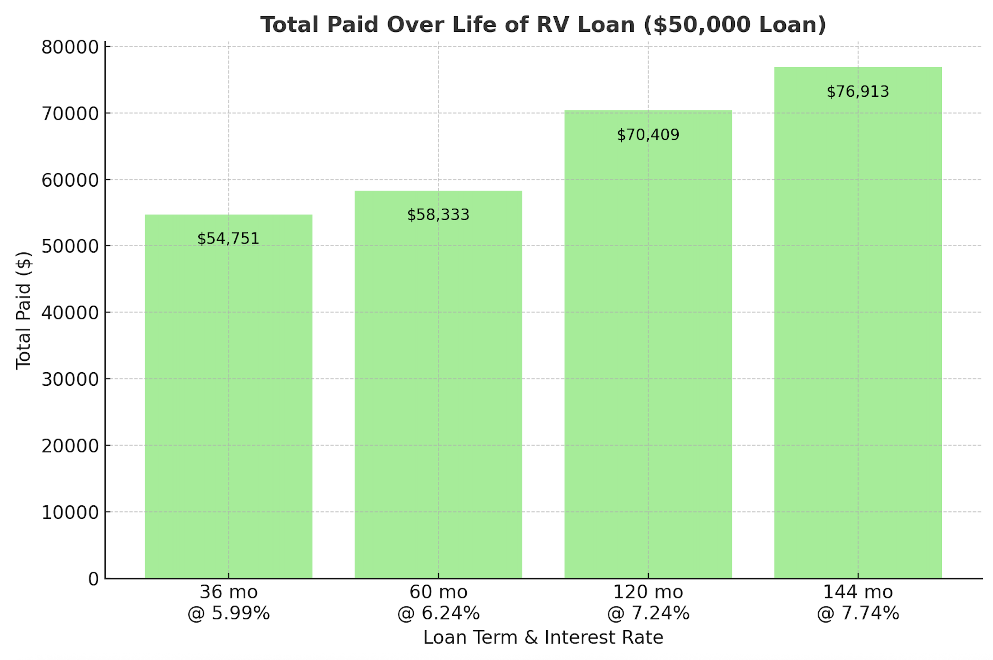
What Difference Does It Make …

Slide 25
🤔 Why Some Buyers Accept Higher Rates, Longer Terms, or Dealer Financing
Higher Interest Rate:
  Credit score limits best options
  Urgency – want the RV now
  Focused on monthly payment
  Unaware of better options
Longer Term:
  Lower monthly payments
  Free up cash for other expenses
  Inflation mindset – future dollars are cheaper
Dealer Financing:
  Convenience – all in one place
  They can get deals done if they want to!

Slide 26
When They Ask …
Are you going to be financing the purchase?
Your answer is …
  “Not sure yet. We plan to pay cash! We are already pre-approved with (source) and could go that route if we decide using someone else’s money is more attractive than using ours!”
If you are actually planning to finance you will eventually ask them what their interest rate would be?
  They will answer … “that depends on your credit score”.
  Never tell them what rate you have already secured.

Slide 27
Summary …
Shop interest rates!
Consider all of your options …
Understand the true cost of your options …
Get pre approved!
Make the dealer compete for your financing and add on’s!!!

Slide 28
The 'Game' of Buying!
Strategies to Save Thousands When Buying Your Next RV

Slide 29
💸 How Dealers Price and Discount RVs
Dealers start high to leave room for negotiation.
Psychology: big 'discounts' make buyers feel like they win!!!

Slide 30
💡 What Determines Dealer Discounts?
Seasonality – more discounts in slow months or end of season.
Inventory pressure – older units cost dealers money the longer they sit.
Sales quotas & incentives – end of month/quarter/year can trigger bigger deals.
Buyer profile – prepared buyers with financing get better offers.
Competition – other dealer quotes create leverage.
Trade-in dynamics – value of your trade affects how flexible they are.
YOU make a huge difference!!!

Slide 31
💸 How Dealers Price and Discount RVs
Dealers start high to leave room for negotiation.
Psychology: big 'discounts' make buyers feel like they win.
Invoice price, dealer incentives, and holdbacks matter.

Slide 32
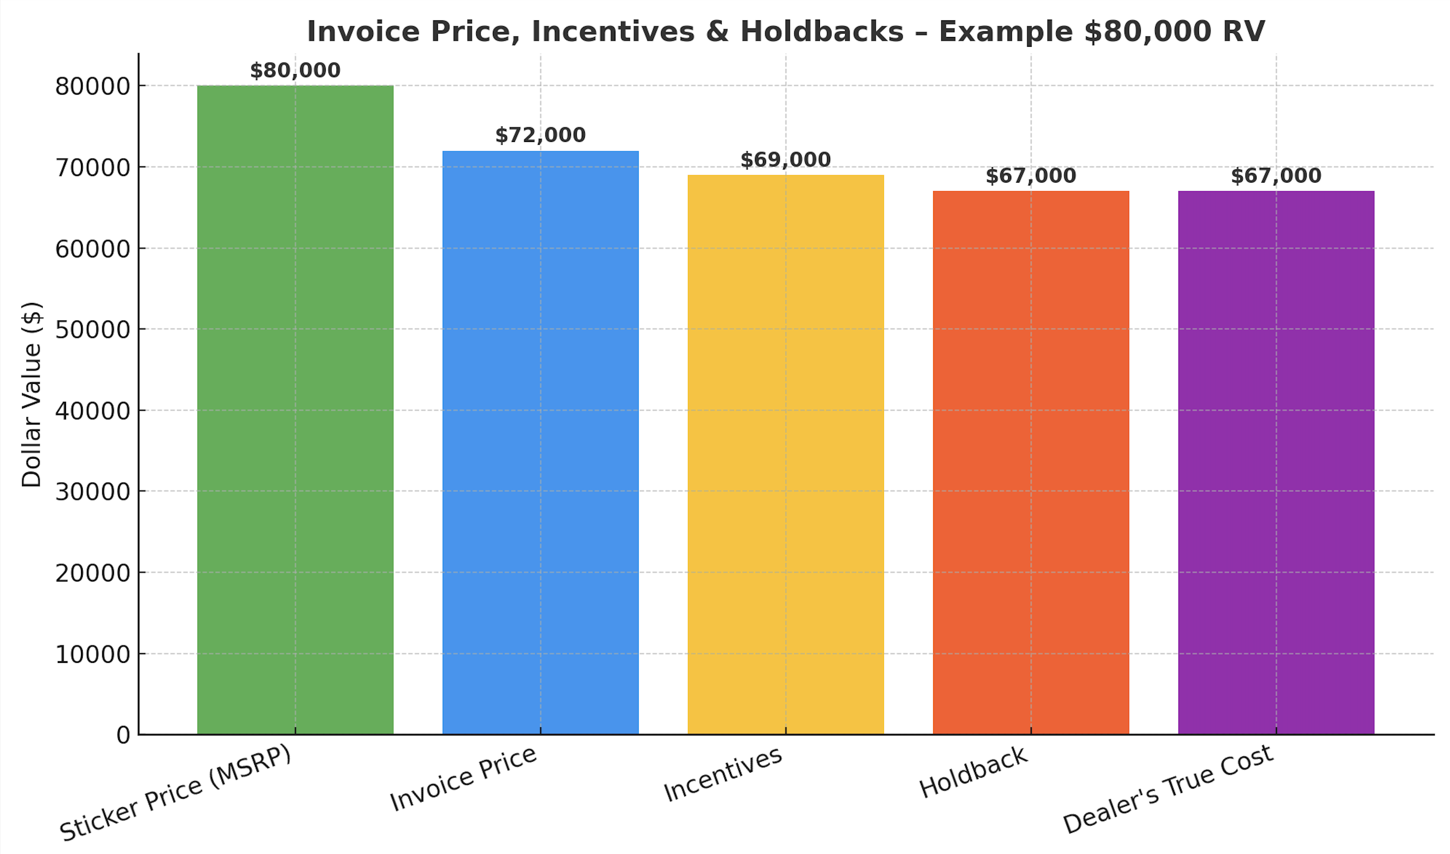
💸 How Dealers Price and Discount RVs

Slide 33
💸 How Dealers Price and Discount RVs
Dealers start high to leave room for negotiation.
Psychology: big 'discounts' make buyers feel like they win.
Invoice price, dealer incentives, and holdbacks matter.
Add-ons and financing are major profit centers!!!

Slide 34
How to Help Protect Against Unwanted Add Ons!
Shop financing BEFORE stepping on the lot — credit union, bank, or RV lender.
Get every add-on in writing with cost — compare to third-party prices.
Ask: “Is this required?” — most add-ons are completely optional.
Negotiate add-ons like the RV — they’re often marked up 300%+.

Slide 35
📅 Seasonal Buying Patterns
End of season: dealers want to clear inventory.
Winter months: less demand, more buyer leverage.
Spring/summer: peak demand, fewer deals.
End of month/quarter/year – sales team chases quotas.

Slide 36
🧠 Mindset Tips for Buyers
Balance emotion vs. logic – stay focused and enjoy the game.
Define your 'happy range' – know the numbers you’d feel good about.
Recognize the walk-away test – if the dealer lets you leave, you are asking too much.
Focus on out-the-door cash price! Once you have that you can introduce variables!
Remember there’s always another RV – don’t let urgency pressure you.
Control the pace – slow it down, ask questions, don’t rush into signing.

Slide 37
💰 Buying Used – Key Differences
Lower purchase price – less depreciation hit.
Warranty may be expired or shorter.
Condition varies – maintenance records are critical.
Upgrades often included (solar, satellite, etc.).
Financing can be harder to secure or higher rate.

Slide 38
🤝 Buying From an Individual
No dealer fees – potential to save thousands.
Private sale = no warranty or dealer service support.
Do your own due diligence: inspection, title, lien check.
Payment and paperwork must be handled securely.
Negotiation may be more flexible than with a dealer.

Slide 39
When Buying From an Individual …
Inspection is non-negotiable – hire a certified RV inspector/mechanic.
Verify paperwork and ownership – title, VIN, lien check, bill of sale.
Request maintenance records – service logs and receipts are valuable.
Handle payment safely – use bank transfer or escrow, avoid cash scams.
Be realistic – sale is usually 'as is’ so “buyer beware!!!
Negotiation can run the full gamut – could get a steal or could get a looney tunes episode!

Slide 40
Buying Used: Price & Negotiation
Buying from an Individual:
  Lower prices — no overhead or dealer markup
  Flexible, motivated sellers may take less
  Higher risk of hidden issues
Buying from a Dealer:
  Higher prices — includes overhead & reconditioning
  More structured negotiation — less wiggle room
  Peace of mind from inspections

Slide 41
Buying Used: Protection, Financing & Paperwork
Buying from an Individual:
  No warranty — 'as is' only
  Financing harder — must arrange personally
  Buyer responsible for DMV, title, lien clearance
Buying from a Dealer:
  Warranties or service contracts available
  In-house financing (sometimes higher rates)
  Dealer handles paperwork, title, registration

Slide 42
Buying Used: Convenience, Selection & Support
Buying from an Individual:
  Limited to one unit — no alternatives
  Slower process — inspections & paperwork on you
  No after-sale support
Buying from a Dealer:
  Wide selection to compare
  One-stop shop — faster & easier transaction
  Service, trade-in options, and ongoing support

Slide 43
🎯 The Game of Buying – Key Lessons
Mindset matters …
Dealers start high – discounts are part of the game.
Invoice, incentives, and holdbacks mean real dealer cost is lower than you see.
Seasonality, quotas, and inventory drive discount flexibility.
Your preparation, financing, and mindset make a huge difference.
Used vs new? There is no right answer for everyone!!!

Slide 44
✅ Key Takeaways
Confidence comes from preparation, knowledge, and mindset.
The right floor plan, dealer, and salesperson save time & money.
Financing: pre-approval gives you control and saves thousands.
Dealers always have room to negotiate – timing & competition matter.
There’s no single right answer – new vs. used depends on your needs.
Stay logical, patient, and willing to walk away.

Slide 45



Jim & Christie Jacobus
JoyHauling With Team Jacobus
Keep in touch with us and let us know how we can continue to serve you and your journey!
E:mail: Jim@TeamJacobus.com
Phone: 281-725-8367
WWW.JoyHauling.Com

